Slide 1
Topology of Flight Paths
Tobias Soltvedt

Slide 2

The Problem:
Flight traffic data is complex and noisy.
Overall shape of flight paths are often overlooked.
Is Topological Data Analysis (TDA) viable for flight traffic data?
TDA applies topological methods to analyze data.

Slide 3
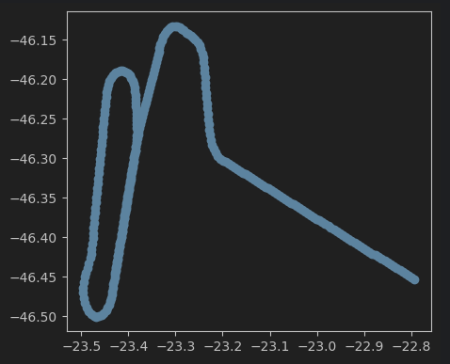
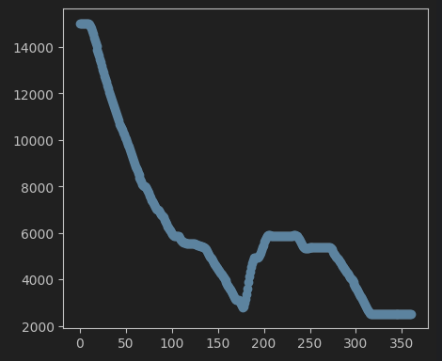
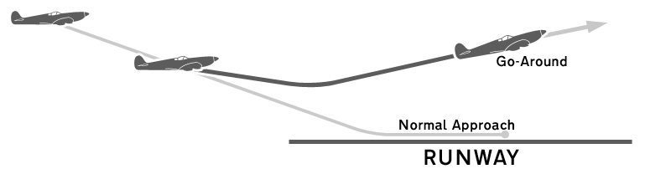
Using TDA for Go-Around(GA) detection
A GA is a flight maneuver.
A plane aborts landing last minute.
Happens due to runway issues, weather, or unstable approach.
The plane then readjusts to attempt landing again.
TDA may help as the GA can often be seen in the shape of the flight path.

Slide 4
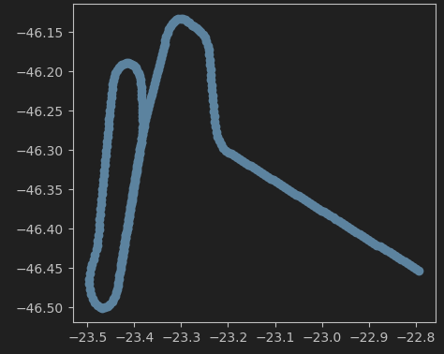
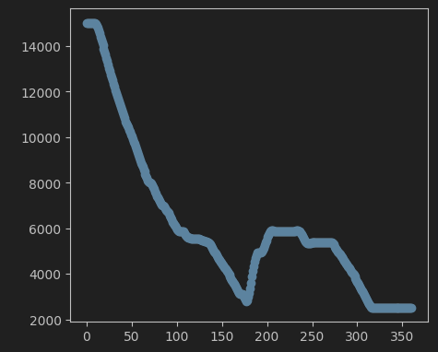
Process:
First: Baseline model:
Naïve detection using basic flight parameters (e.g., altitude, speed).
Second: Add 2D latitude/longitude TDA data:
Captures 2D features
Third: Add altitude TDA data:
Detects topological signatures of climbs/descents

Slide 5
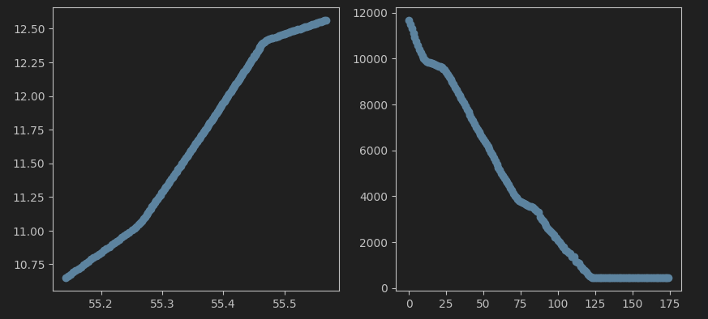
Naïve model results:
Surprisingly, good results
~98% balanced accuracy on validation
Example of a unique False Positive:

Slide 6
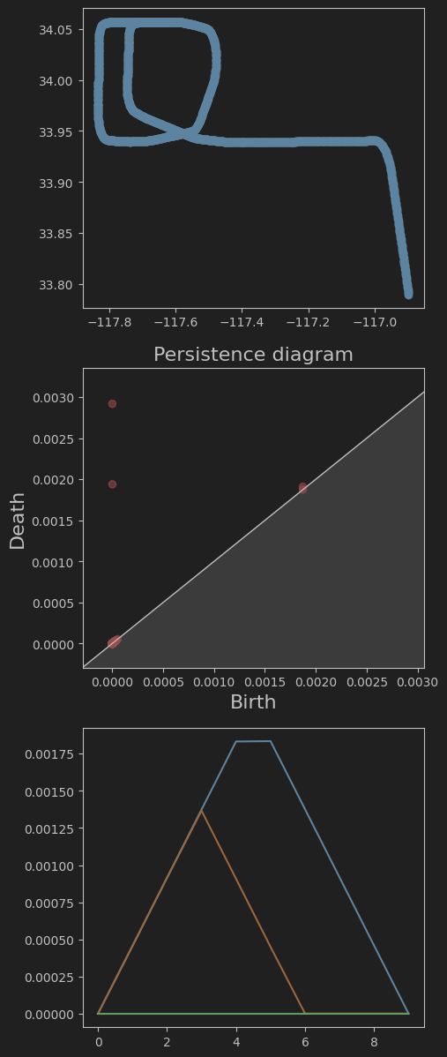
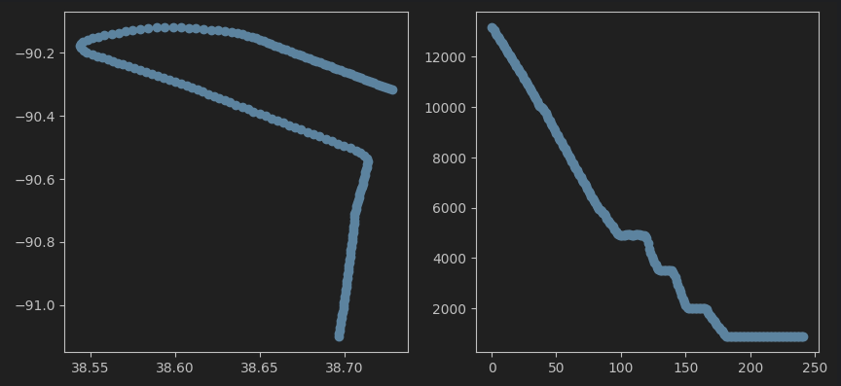
Latitude-longitude topological data
Latitude-longitude topological data alone:
~94% balanced accuracy on validation
Naïve model + Latitude-longitude topological data
~99% balanced accuracy on validation
Example of a unique False Positive:

Slide 7
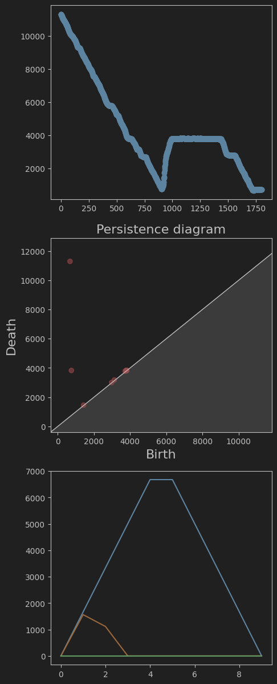
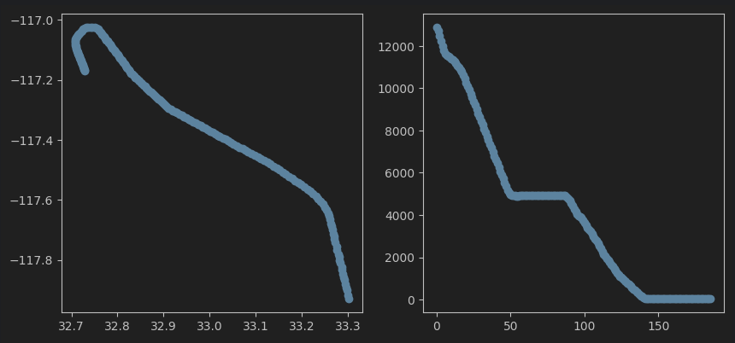
Altitude topological data
Altitude topological data alone:
~90% balanced accuracy on validation
Naïve model + Altitude topological data
~99% balanced accuracy on validation
All 3 datasets combined:
~99% balanced accuracy on validation
Unique false positive:

Slide 8
What’s next?
The baseline model is really accurate by itself
TDA data can make it slightly more accurate
TDA struggles slightly by itself…
Performance is so high on all models that it’s tough to see a difference
Maybe add more complexity to the problem?
Maybe change how I vectorize the TDA?

